Slide 1
Stock value prediction using Regression Algorithms

Slide 2
Group Member Info:
AKSHAY MITTAPALLY – 700747142
RANJITH KUSTHAPURAM – 700733555
CHANDHINI NADUKUDA – 700741073
SHEEBAJOY MANDAPATI - 700740580

Slide 3
Roles and Responsibilities:
AKSHAY – Implemented the coding for loading dataset.
RANJITH – Worked on identifying the necessary papers for the project work implementation.
CHANDHINI - Dataset collection based on the requirement for the project.
SHEEBAJOY – Worked on the documentation what we have done.

Slide 4
Motivation
Stock market prediction has long been a topic of significant interest and research due to its potential implications for investors, traders, and financial institutions.
Ability to accurately predict stock prices can provide significant advantages in terms of making informed investment decisions, managing portfolios, and mitigating risks.
Motivation for using regression algorithms for stock market prediction is driven by the potential benefits they offer in terms of improved investment decision making, risk management, efficient portfolio management

Slide 5
Objective
Forecast future changes in a commercial lender's share price.
Predicting the future stock price using regression algorithms such as linear and polynomial.
Main objectives of stock market prediction using regression algorithms include achieving high prediction accuracy.
Objectives aim to develop reliable, interpretable, and robust regression models that can provide accurate predictions of stock prices

Slide 6
Related work
Research explored the use of various regression algorithms, including linear regression, k-nearest neighbors regression, and artificial neural networks, for predicting stock prices.
This study used linear regression and polynomial regression to predict stock prices. The authors investigated the impact of various factors, such as market sentiment, stock volume, and financial news sentiment, on stock price prediction accuracy.
This research compared the performance of different regression algorithms, including linear regression, random forest regression, and gradient boosting regression, for stock market prediction. The authors evaluated the algorithms on various metrics, such as RMSE and MAPE, and identified the best-performing algorithm for stock price prediction.

Slide 7
Problem statement
stock market is known for its dynamic and volatile nature, where the prices of stocks can fluctuate rapidly, making it challenging for investors to accurately predict their future values.
complex and unpredictable factors that influence stock prices, such as market sentiment, economic indicators,
ultimate goal of the problem statement is to develop a robust and scalable predictive model that can effectively forecast stock values with a high degree of accuracy.

Slide 8
Proposed Solution
Linear regression is a statistical method used to model the relationship between two variables by fitting a linear equation to observed data.
Popular and widely used algorithm for predicting numeric values based on input features.
Objective of using linear regression in stock market prediction is to develop a mathematical model that can estimate the relationship between input features

Slide 9
Polynomial
Type of regression analysis that extends the linear regression model by including higher-order polynomial terms to capture nonlinear relationships between variables.
Objective of using polynomial regression in stock value prediction is to develop a mathematical model that can accurately estimate the relationship between input features and the target variable.
Objectives of using polynomial regression in stock value prediction are to capture nonlinear patterns, improve model accuracy, manage model interpretability and overfitting, and perform feature selection.

Slide 10
Results
Stock value prediction using regression algorithms is a complex task that involves analyzing historical data and identifying patterns to make predictions about future stock prices.
Evaluated using metrics such as mean squared error (MSE), root mean squared error (RMSE), mean absolute error (MAE), and R-squared (R2).
Stock value predictions are not guarantees of future performance and should be used as one of many tools in making informed investment decisions.

Slide 11
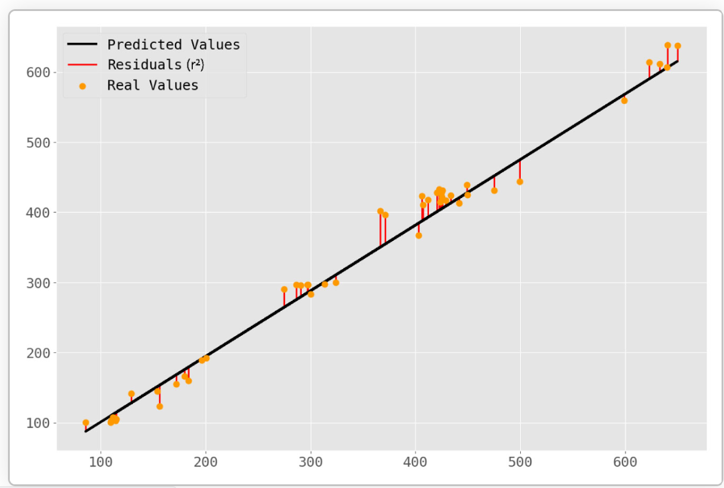
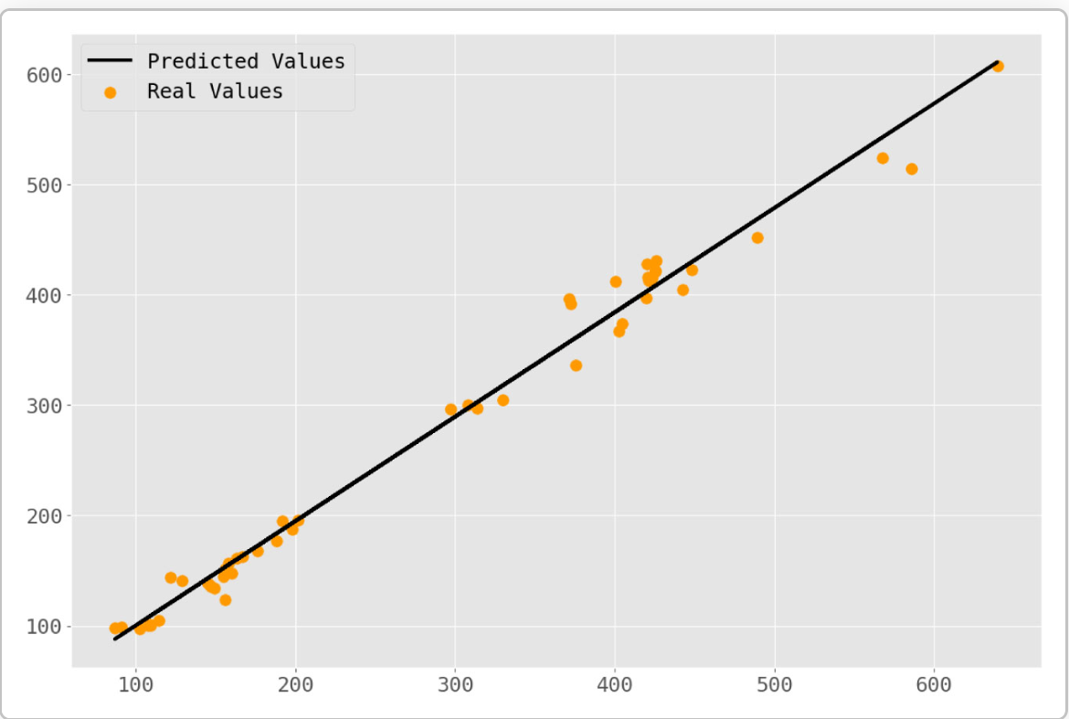

Slide 12
References
N. S. K. S. Shouvik Banik, “Analysis of Regression Techniques for Stock Market Prediction: A Performance Review,” 2021 9th International Conference on Reliability, Infocom Technologies and Optimization, 2021.
Saheli Roy Choudhury, "Machines will soon will be able to learn without being programmed",Available:https://www.cnbc.com/2018/04/17/machine-learning-investing-in-ai-next-big-thing.html.
Ashish sharma, dinesh bhuriya and upendra singh, "Survey of Stock Market Prediction Using Machine Learning Approach", International Conference on Electronics Communication and Aerospace Technology ICECA, 2017.

